Slide 1

Project on
Grocery Store Management
Presented by :
B Dinesh
B Naga Sai

Slide 2
Introduction
The Retail and Grocery sector depends heavily on smooth management of products, suppliers, customers, and employees.
Proper data management helps in tracking sales, monitoring stock, and understanding business performance.
This project builds a mini grocery store database that connects different parts of the business, like products, orders, and suppliers.
It gives a practical learning experience in managing and analysing real-world data relationships.
Using SQL queries, we can extract important information, spot trends, and solve operational challenges.
The main aim is to make better business decisions and improve the overall efficiency of the store.

Slide 3




Tables
supplier
employees
categories
customers

Slide 4

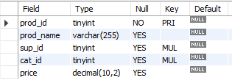
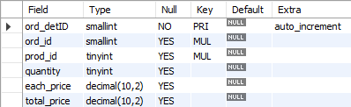
Tables
orders
products
order_details

Slide 5
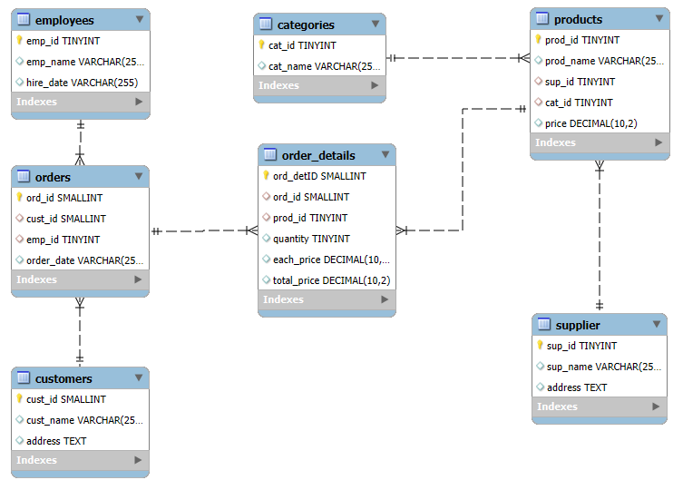
ER Diagram

Slide 6
Problem Statement
In the dynamic environment of a retail grocery store, managing and analyzing large volumes of data related to products, suppliers, customers, and orders is crucial for efficient operations and informed decision making. This project aims to design and implement a relational database system that captures essential store activities and enables users to retrieve and analyze data through SQL. The system will support complex queries to identify key business insights such as top performing products, high value customers, and revenue patterns, while reinforcing practical SQL skills including joins, aggregations, subqueries, and filtering.

Slide 7
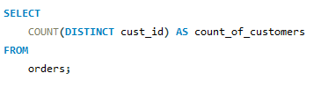

1.How many unique customers have placed orders?

Slide 8
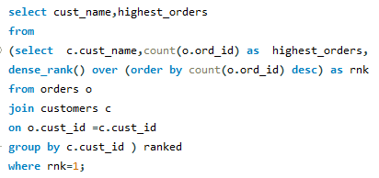

2.Which customers have placed the highest number of orders?

Slide 9
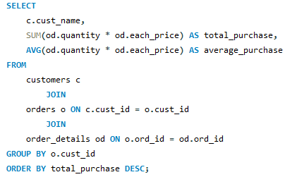
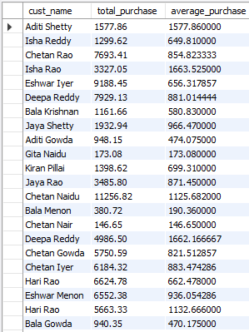
3.What is the total and average purchase value per customer?

Slide 10
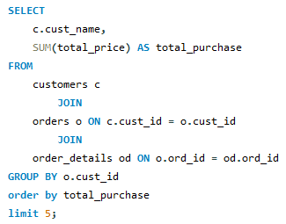
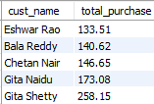
4.Who are the top 5 customers by total purchase amount?

Slide 11
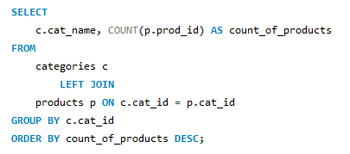
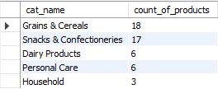
5.How many products exist in each category?

Slide 12
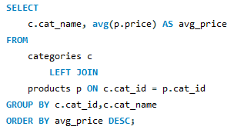
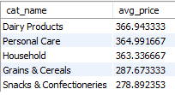
6.What is the average price of products by category?

Slide 13
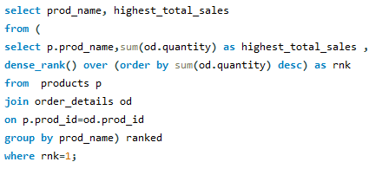

7.Which products have the highest total sales volume (by quantity)?

Slide 14
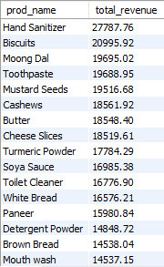
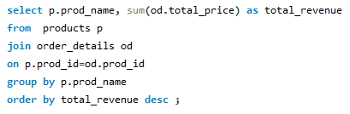
8.What is the total revenue generated by each product?

Slide 15
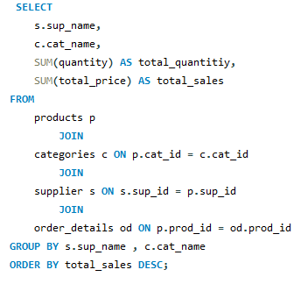
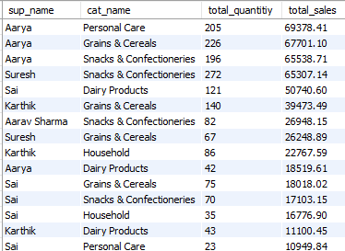
9.How do product sales vary by category and supplier?

Slide 16
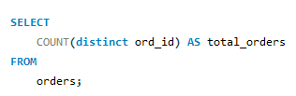

10.How many orders have been placed in total?

Slide 17
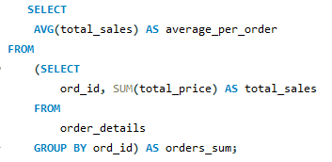

11.What is the average value per order?

Slide 18
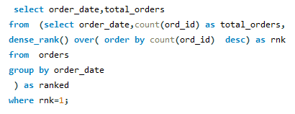

12.On which dates were the most orders placed?

Slide 19
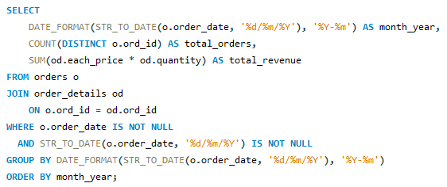
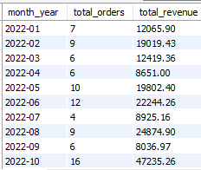
13.What are the monthly trends in order volume and revenue?

Slide 20
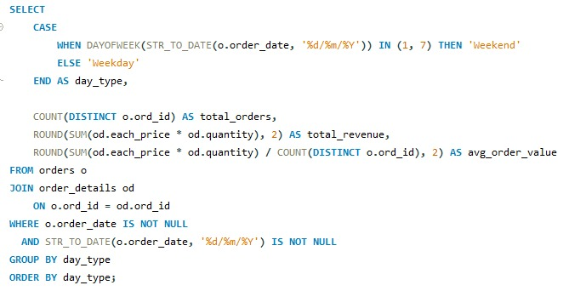

14.How do order patterns vary across weekdays and weekends?

Slide 21


15.How many suppliers are there in the database?

Slide 22
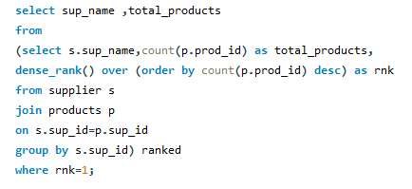

16.Which supplier provides the most products?

Slide 23
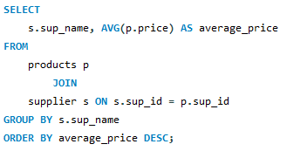
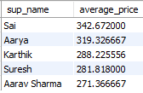
17.What is the average price of products from each supplier?

Slide 24
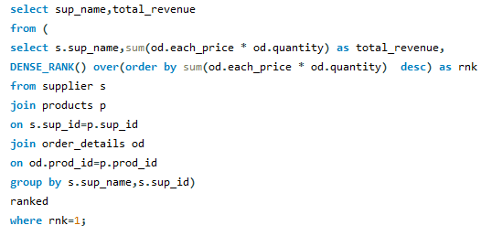

18.Which suppliers contribute the most to total product sales (by revenue)?

Slide 25


19.How many employees have processed orders?

Slide 26
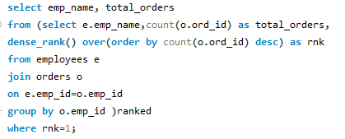

20.Which employees have handled the most orders?

Slide 27
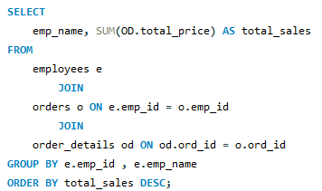
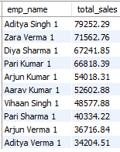
21.What is the total sales value processed by each employee?

Slide 28
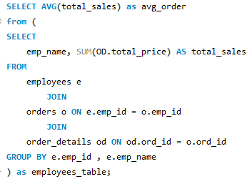

22.What is the average order value handled per employee?

Slide 29
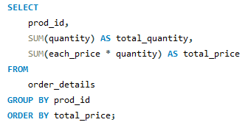
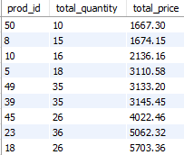
23.What is the relationship between quantity ordered and total price?

Slide 30
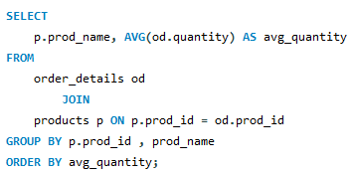
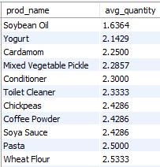
24.What is the average quantity ordered per product?

Slide 31
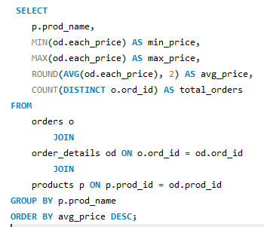
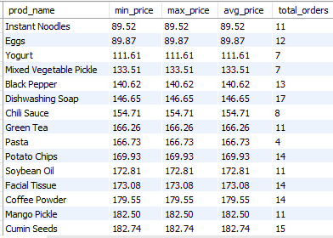
25.How does the unit price vary across products and orders?

Slide 32


